Slide 1
AGENTIC AI
Industry Usecases and Current Challenges
Dr. Adilakshmi Vadavalli, PhD
Senior Data Scientist | Solution Architect | AWS & Azure Specialist | Capgemini

Slide 2


ABOUT THE SPEAKER
Dr. Adilakshmi Vadavalli, PhD
Senior Data Scientist | Solution Architect | AWS & Azure Specialist | Capgemini
Extensive experience across data science, cloud solution architecture, and enterprise AI delivery.
AWS & Azure specialist, designing production-grade ML and GenAI systems for global clients.
Focus areas: MLOps, Generative AI, and Agentic AI systems — from prototypes to production.
Regularly engages with academia through industry expert sessions, FDPs, and case-study workshops.
Let's Connect on LinkedIn
Scan the QR code to view my profile, projects, and future sessions.
02

Slide 3
SESSION AGENDA
What We'll Cover Today
01
Foundations of Machine Learning & MLOps
MLOps fundamentals, the six jars of ML, and 9 essential algorithms
02
The Shift to Agentic AI
MLOps vs GenAIOps vs AgenticAIOps, and core agentic design patterns with industry use cases
03
Evaluating LLMs & Agentic Systems
Chatbot, classification, and information-extraction evaluation frameworks
04
Engineering Practices, Governance & Careers
Vibe coding vs spec-driven dev, AI guardrails, data sovereignty, and the Forward Deployed Engineer role
05
Current Challenges in Agentic AI
What's still hard in production — and how the industry is responding
06
Key Takeaways & Open Discussion
Wrap-up and Q&A
03

Slide 4
01
PART 01
Foundations of Machine Learning & MLOps
MLOps fundamentals, the six jars of ML, and essential algorithms

Slide 5
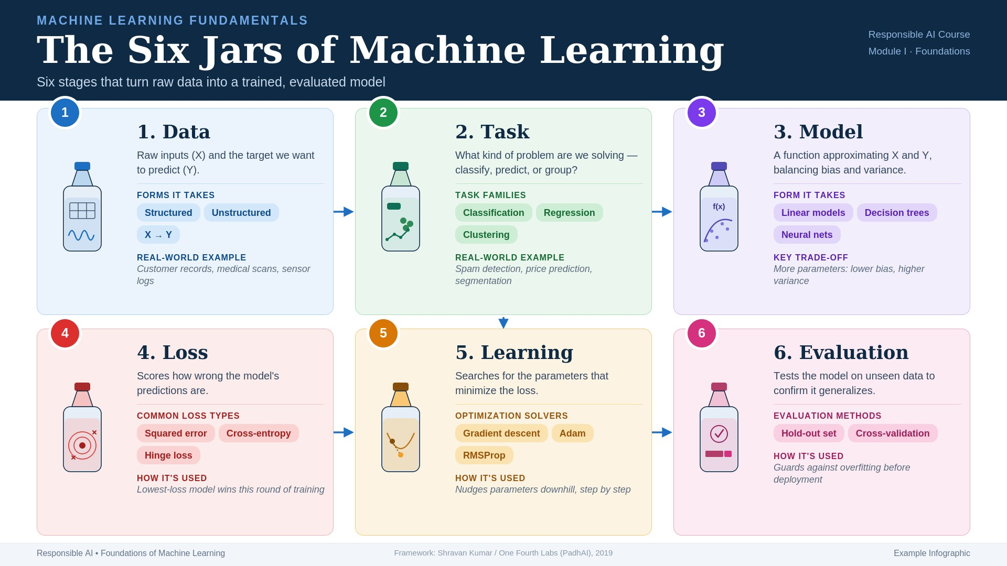

Slide 6
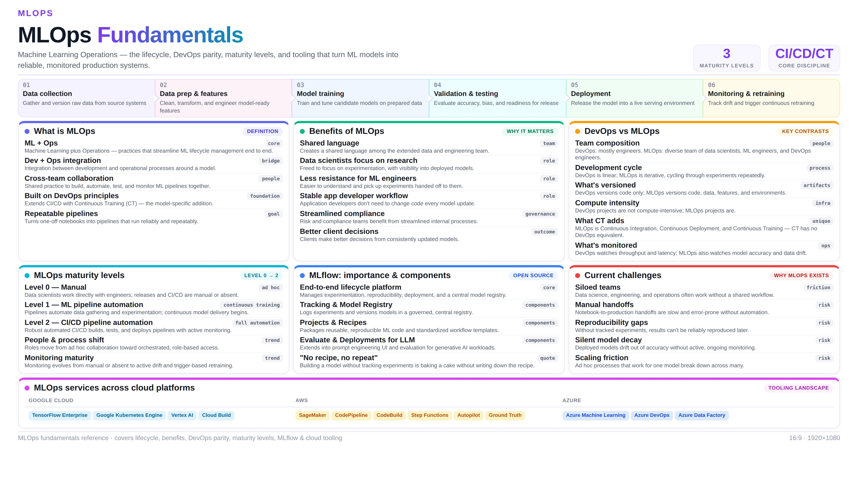

Slide 7
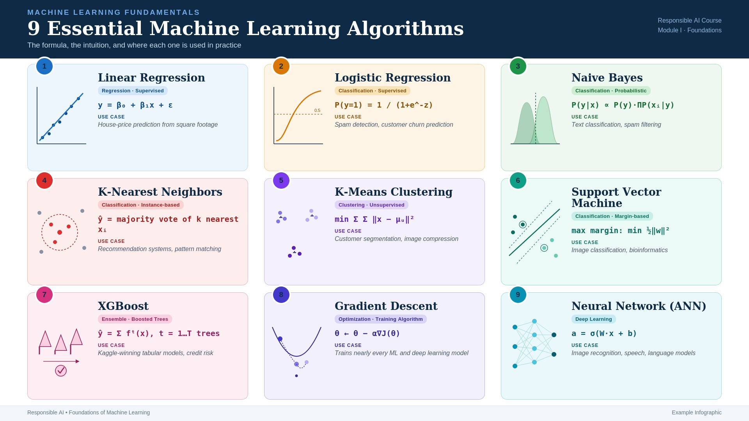

Slide 8
02
PART 02
The Shift to Agentic AI
From predictive models, to generative models, to autonomous agents
Sathyabama Institute of Science and Technology • School of Computing • AI & ML

Slide 9

THE AGENTIC AI UNIVERSE
Zooming into the “AI Agents” planet — the building blocks that power one autonomous system
2026 FRONTIER
Orchestrator-Worker · MCP Protocols
INDUSTRY UNIVERSE
OPEN CHALLENGES
Finance • Healthcare • Retail • Logistics
Cost · Latency · Trust
1
Perception
3
Tool Use
5
Multi-Agent
AGENTIC AI
CORE
2
Memory
4
Planning
6
Guardrails
Perception Understands the raw request
Memory Retains context across steps
Tool Use Calls APIs to act on the world
Planning Breaks goals into ordered steps
Multi-Agent Specialists coordinate together
Guardrails Keeps action safe & accountable

Slide 10
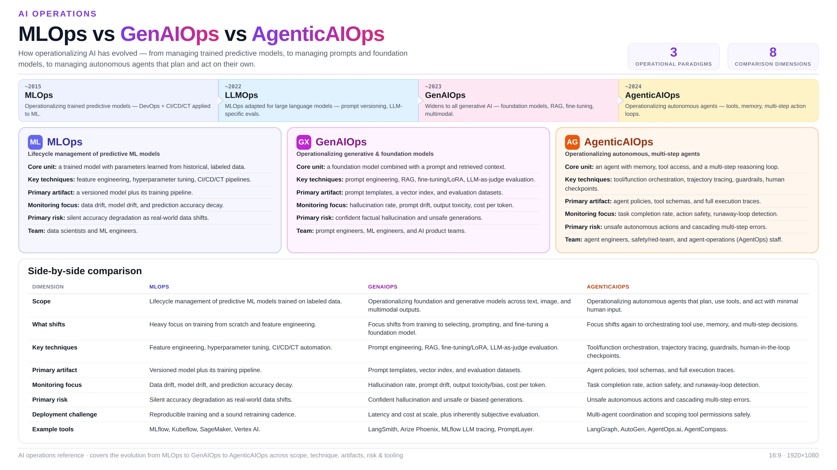

Slide 11
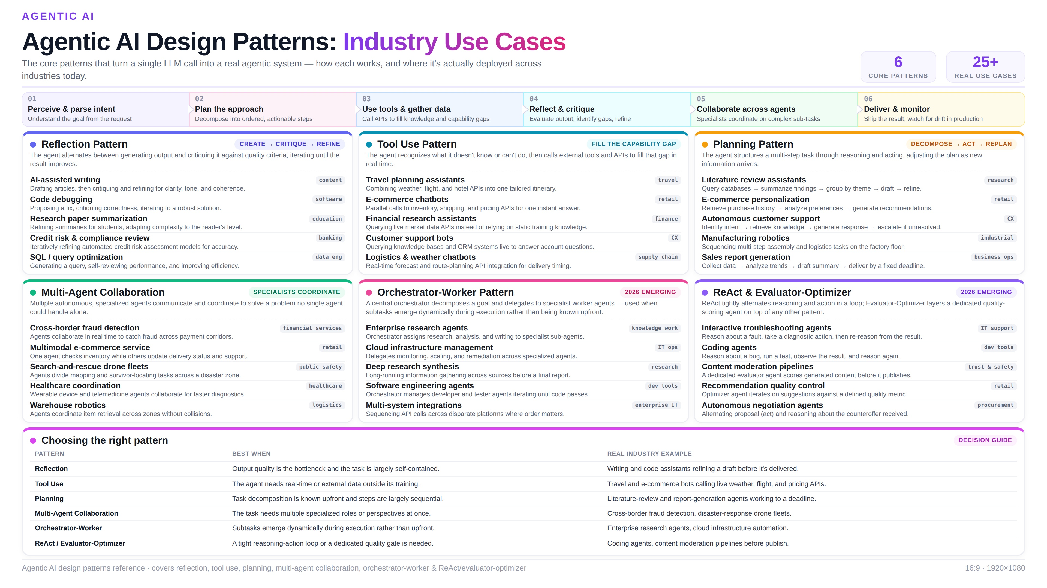

Slide 12
03
PART 03
Evaluating LLMs & Agentic Systems
How we measure quality, accuracy, and reliability in production

Slide 13
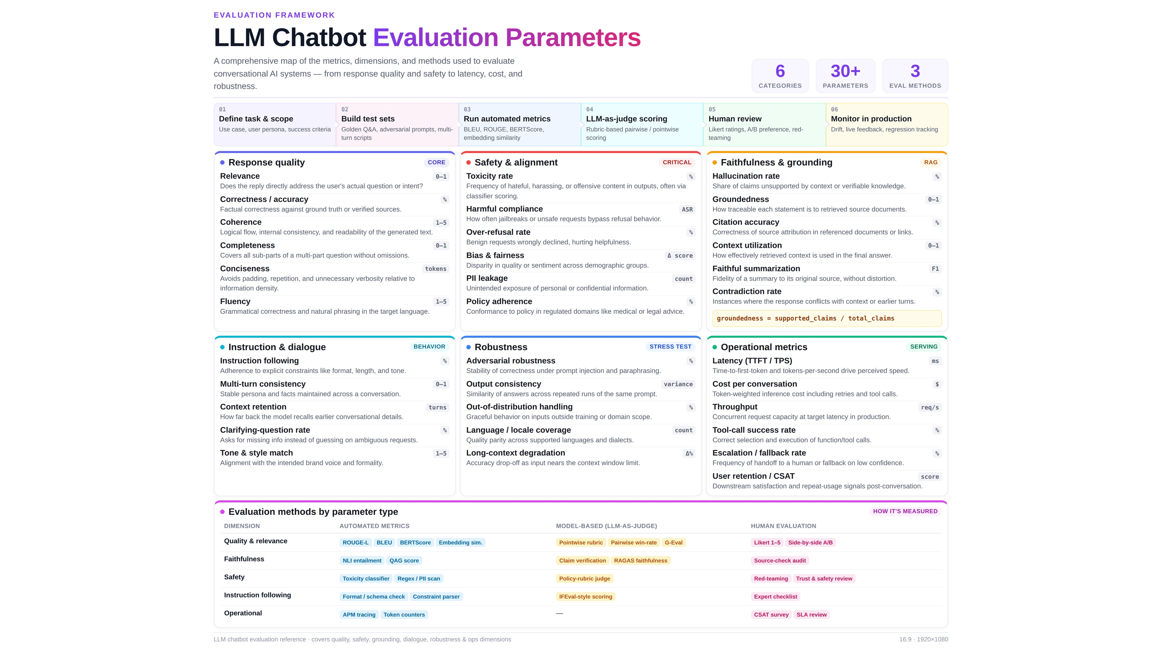

Slide 14
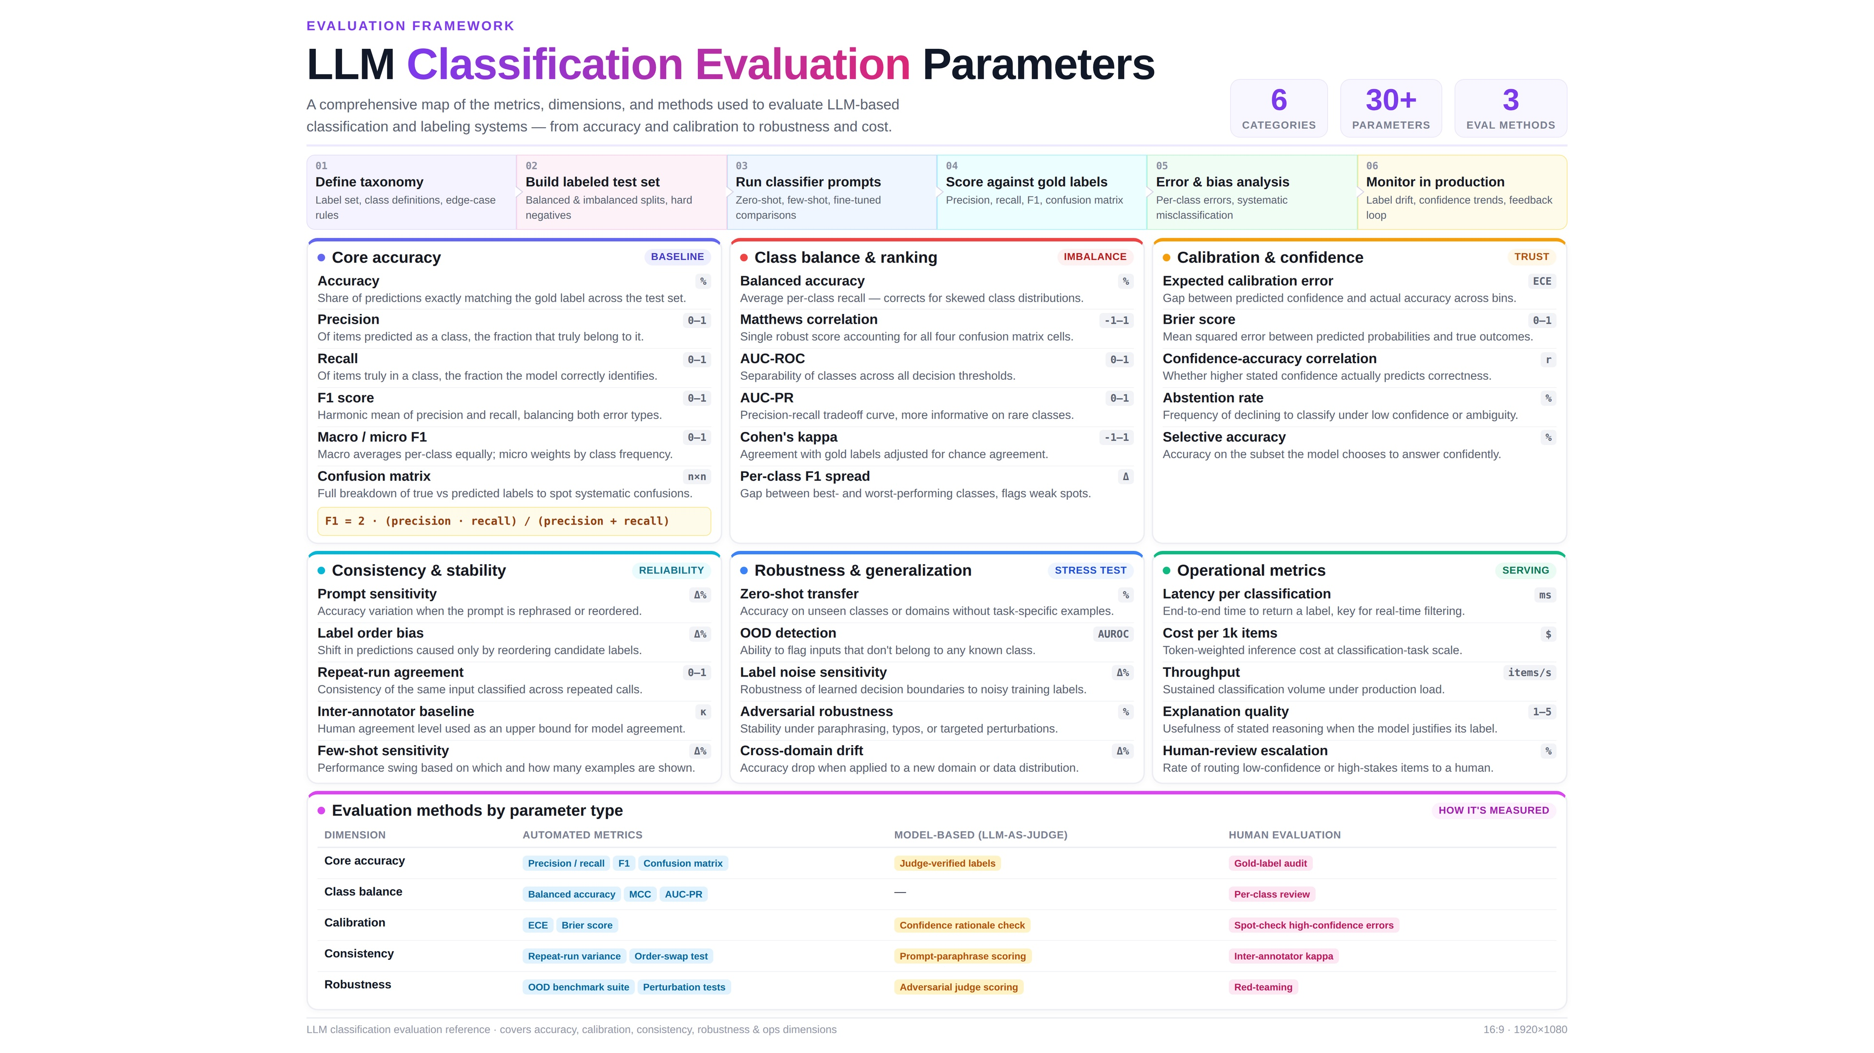

Slide 15
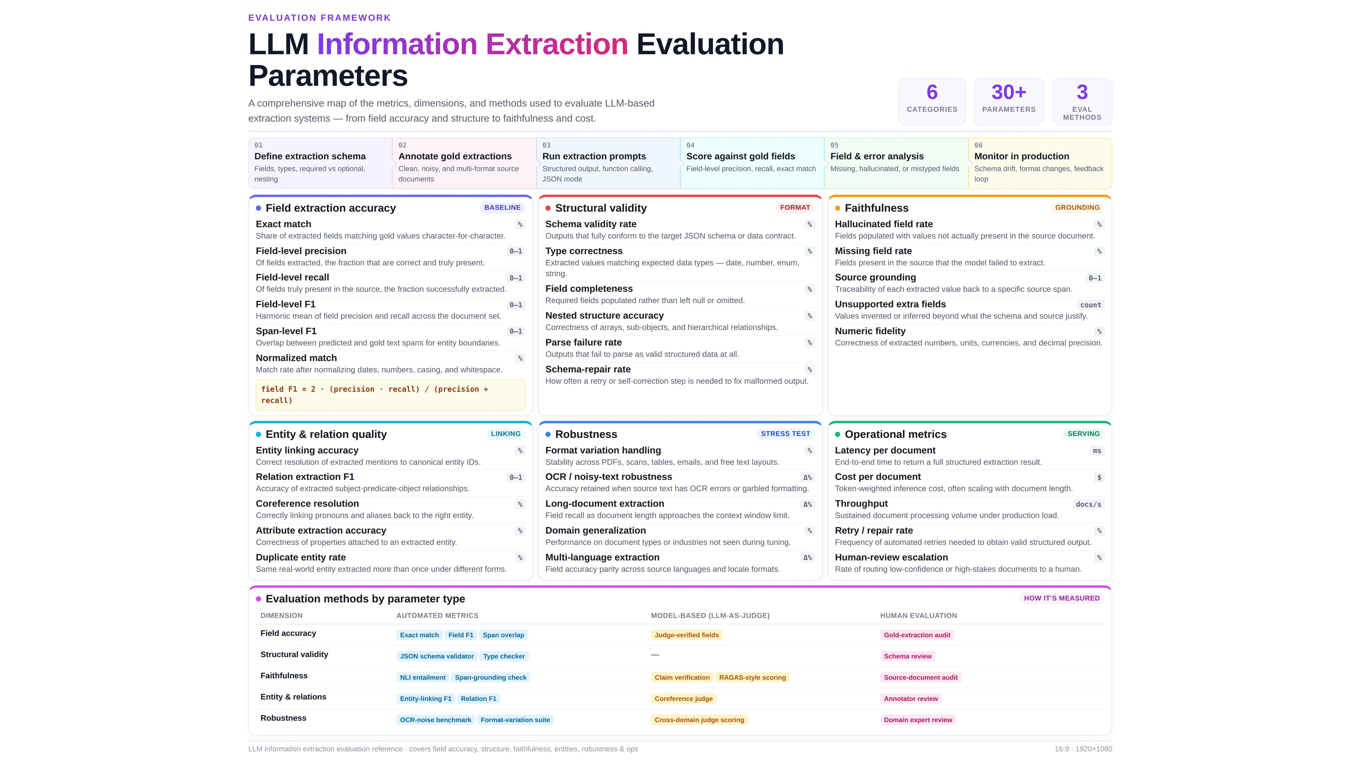

Slide 16
04
PART 04
Engineering Practices, Governance & Careers
Building, governing, and deploying agentic AI responsibly

Slide 17
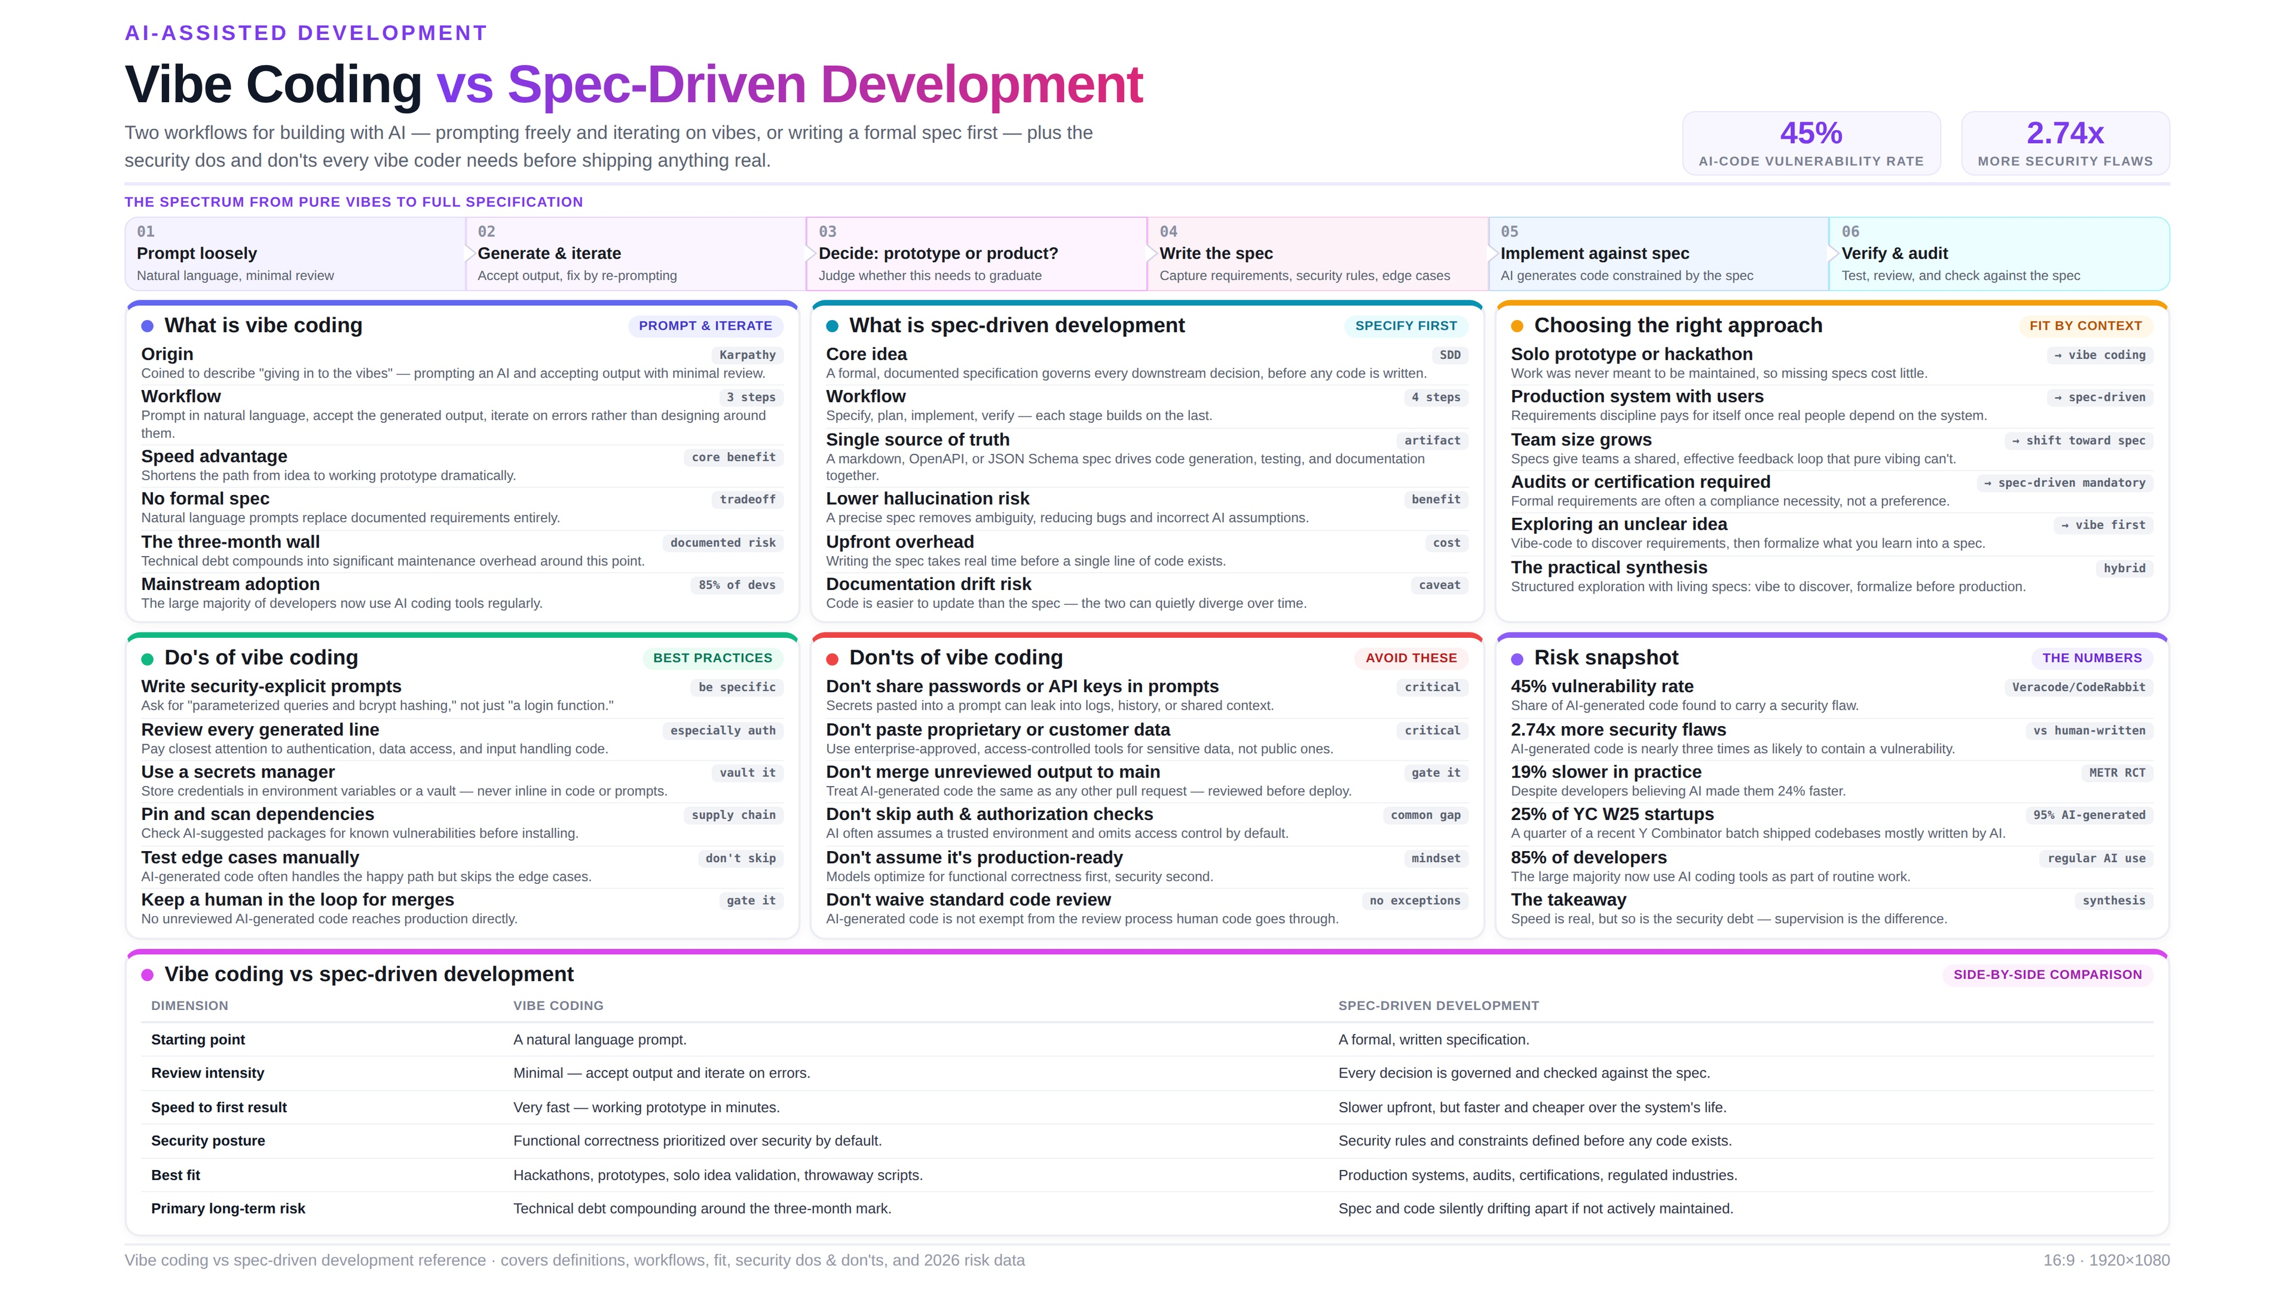

Slide 18
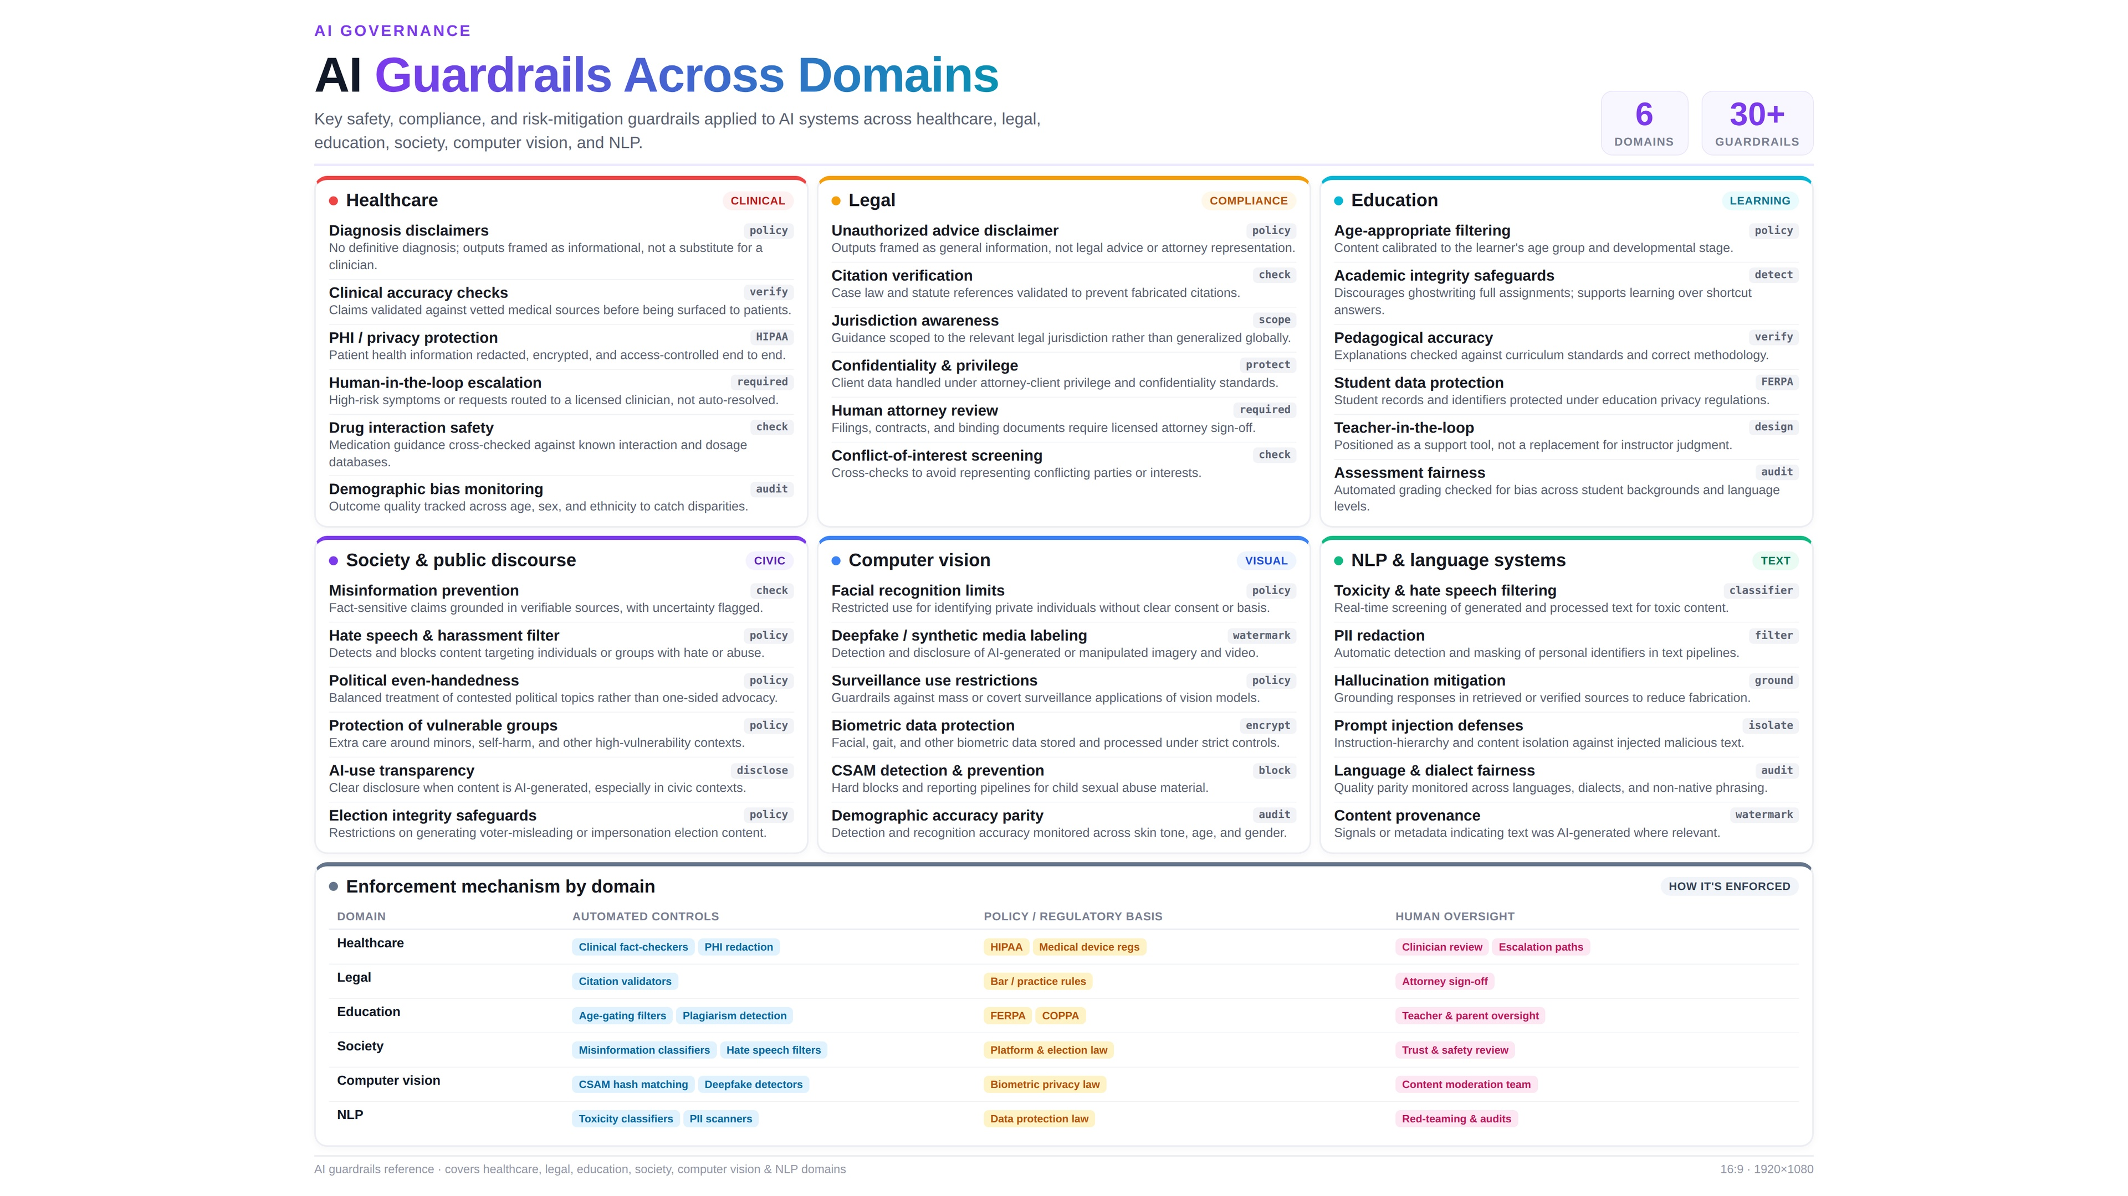

Slide 19
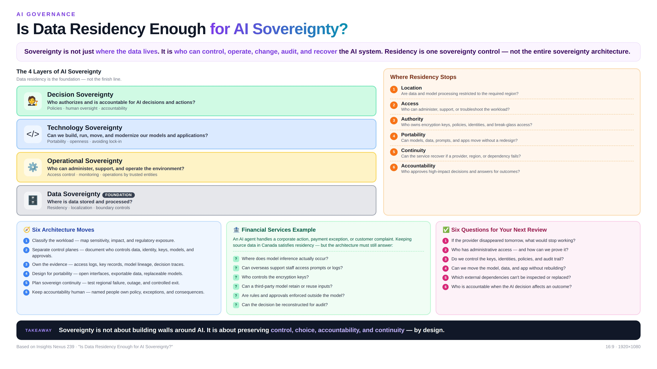

Slide 20
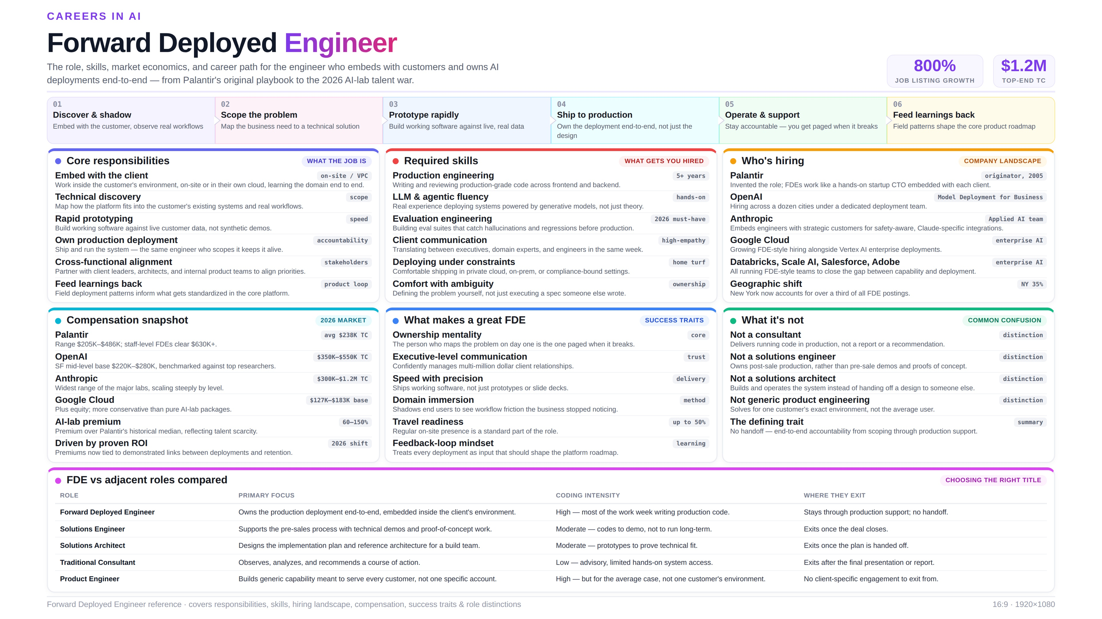

Slide 21
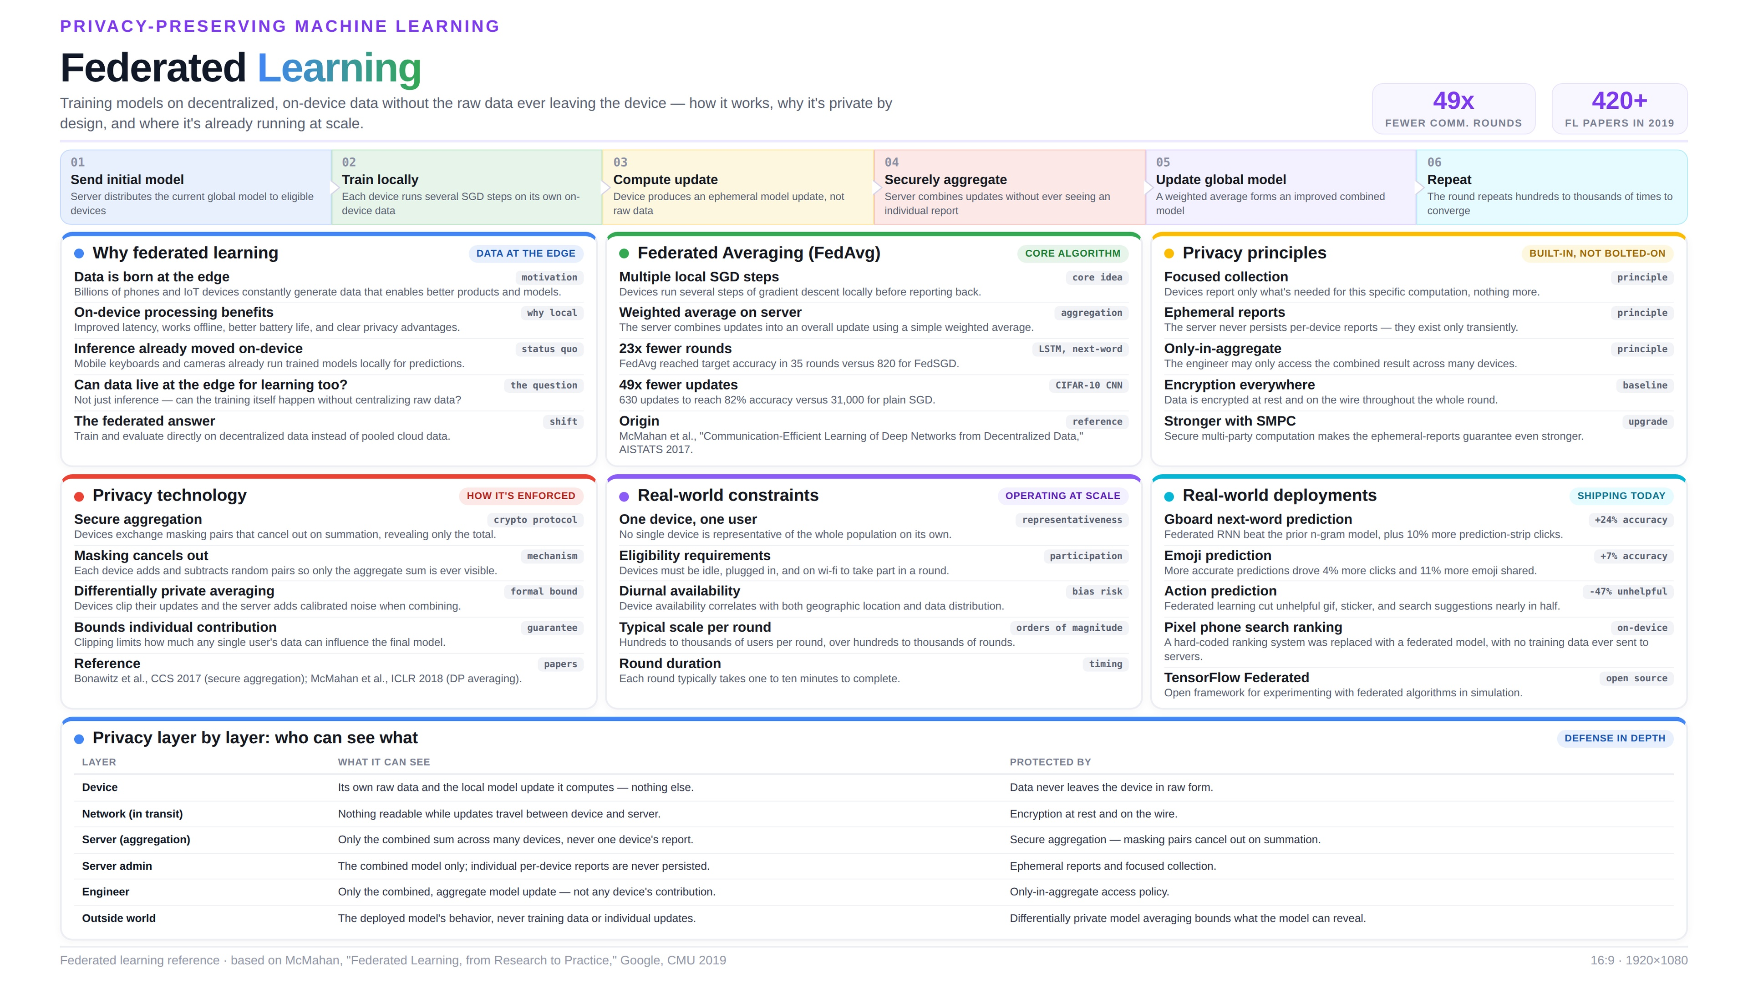

Slide 22
REAL-WORLD DEPLOYMENTS
Agentic AI in Action: Enterprise Use Cases
Six production deployments spanning finance, procurement, retail, and insurance
01
Invoice Data Extraction
02
Shop / No-Shop Classification
03
PR to PO Creation
Finance & AP
Retail Field Ops
Procurement
Extracts vendor, line-item, tax, and total fields from invoices automatically.
Classifies field-agent store photos as valid shop visits or invalid submissions.
Converts approved purchase requisitions into purchase orders automatically.
04
Journal Transformation
05
POS Tagging in Retail
06
Insurance Policy Extraction & Validation
Accounting & Finance
Retail Analytics
Insurance
Standardizes and transforms raw journal entries into structured accounting formats.
Tags point-of-sale transactions with product, category, and promotion metadata.
Extracts and validates policy fields against underwriting rules for accuracy.

Slide 23
PART 05
Current Challenges in Agentic AI
What's still hard when moving agentic systems from demo to production
Reliability at scale
Tool orchestration failures
Multi-step reasoning still compounds small errors into large failures across long agent trajectories.
Error cascades when one tool call fails silently and downstream steps build on bad data.
Evaluation gaps
Security & prompt injection
No universal benchmark yet for agent quality — teams build custom eval suites per use case.
Untrusted content in tool outputs can hijack an agent's next action if not isolated.
Cost & latency at scale
Governance & accountability
Multi-agent, multi-step workflows multiply token cost and response time quickly.
Unclear ownership when an autonomous action causes a real-world consequence.
Talent gap
Data & model sovereignty
Few engineers are yet skilled in agent evaluation, orchestration, and safe deployment.
Enterprises need control, not just residency, as agents span regions and vendors.

Slide 24
PART 06
Key Takeaways
1
Agentic AI is a genuine architectural shift — from operationalizing trained models (MLOps) to orchestrating autonomous, tool-using agents (AgenticAIOps).
2
The core patterns — Reflection, Tool Use, Planning, and Multi-Agent Collaboration — already power real production systems across finance, healthcare, logistics, and retail.
3
Evaluation is not optional: without eval suites for chatbots, classifiers, and extraction pipelines, quality regressions reach users unnoticed.
4
Speed from AI-assisted coding is real, but so is the security debt — pair vibe coding with review discipline and spec-driven practices for production.
5
Responsible deployment means treating fairness, privacy, guardrails, and sovereignty as first-class architecture decisions, not afterthoughts.
6
New career paths — like the Forward Deployed Engineer — are emerging specifically to close the gap between agentic AI capability and real-world deployment.

Slide 25
Thank You
Questions, discussion, and open floor
Dr. Adilakshmi Vadavalli, PhD
Senior Data Scientist | Solution Architect | Capgemini
Scan to connect on LinkedIn
Sathyabama Institute of Science and Technology • School of Computing • AI & ML

